Slide 1

EQUADE KICK-OFF MEETING
Financial Aspects

Slide 2

EU - REGULATIONS
SPECIAL CONDITIONS
• Financing the Action (Article I.4)
- Annex II – Estimated budget
- Maximum Agency Contribution (Article I.4.3)
- % co-financing
- Transfers between budget headings
- Indirect costs

Slide 3

General
Conditions
Eligible and Ineligible Costs (Article II.14)
Requests for Payment (Article II.15)
Determining the Final Grant (Article II.17)
Recovery (Article II.18)
Checks and Audits (Article II.19)
No longer required to send all supporting
documents strengthened audit policy

Slide 4
Modifications
Prior written request to the EACEA for
authorisation:
Addition of a consortium member
Withdrawal of a consortium member
Changes of contact person at the Beneficiary Institution
Modification of the budget and project’s activities
Extension of the eligibility period
Termination of the Grant Agreement

Slide 5
Budget Modification
PRIOR written authorisation by EACEA is needed for any
increase of the approved amount allocated under each budget heading of direct costs of more than 10%
Requests must indicate the reason and the impact of such
budget modifications on the activities and the expected
outcomes of the modification.
The ceiling for equipment and staff costs (30% and 40% of
the total eligible direct costs shown in Annex II) is not
subject to negotiation. The flexibility of 10% applies also to
the ceilings.
Indirect Costs are not subject to budget modification and
the 10% flexibility do not apply to Indirect Costs.

Slide 6
Submission of
Reports
Intermediate Report
When 70% of the 1st pre-financing has been disbursed
and not later than half way through the eligibility
period:
3 years projects (18 months after start of eligibility period)
Final Report
2 months after the end of the eligibility period.

Slide 7
Financial Report &
Supporting Documents
Documents and financial statements to be sent with the final report and request for payment
OLD APPROACH (Tempus III)
Detailed lists of invoices & a copy of ALL supporting documents
NEW APPROACH (Tempus IV)
Detailed lists of invoices & a copy of SOME supporting documents
Only in specific cases, it is requested that invoices are sent to theExecutive Agency
All original invoices, supporting documents, bank statements are retained with the project accounts.

Slide 8
Financial Report &
Supporting Documents
A copy of some supporting documents only is to be transmitted
with the Final report and Request of payment of the balance
(ref. Guidelines for the use of the grant).
The beneficiaries are requested to keep with the project accounts all
the supporting documents.
If the Executive Agency deems it necessary, copies of invoices and
other supporting documents not required with the Final report can be
requested and examined in detail after the submission of the Report.
These proposed simplifications will be accompanied by a rigorous
audit policy carried out on behalf of the Executive Agency, mainly by increasing the number of ex-post audit missions and of monitoring missions which will also focus on the evaluation of financial aspects.

Slide 9
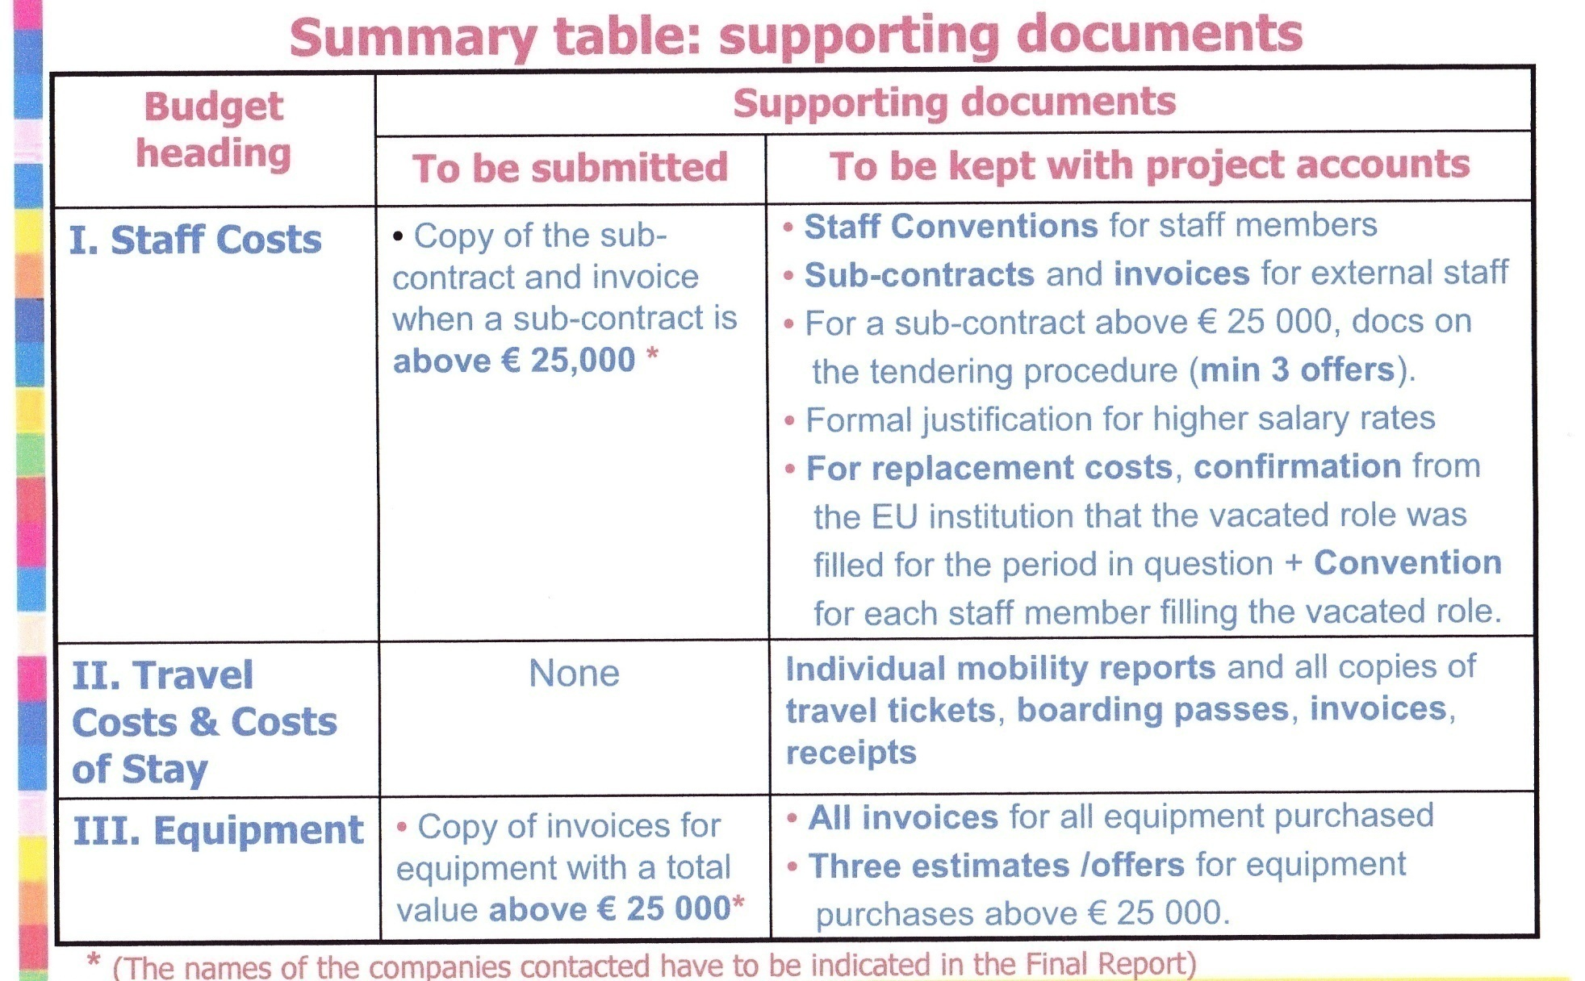
Supporting Documents

Slide 10
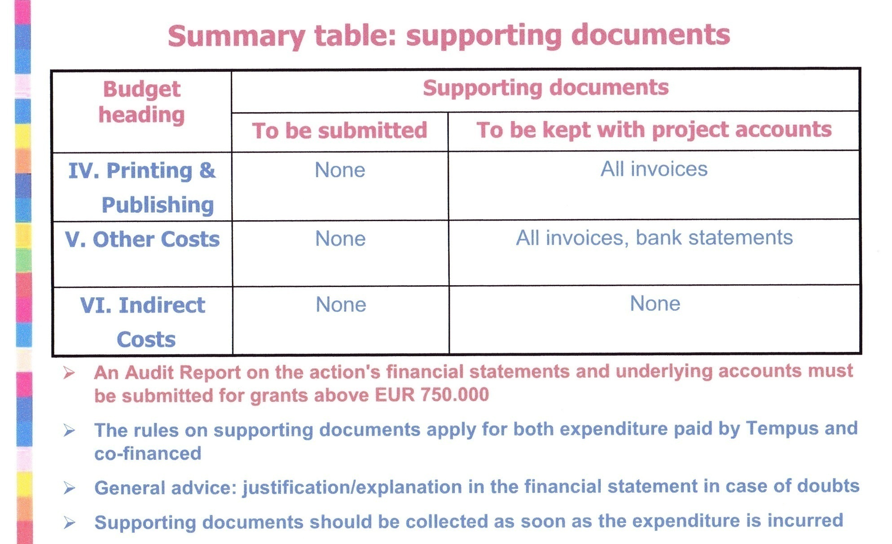
Overview

Slide 11
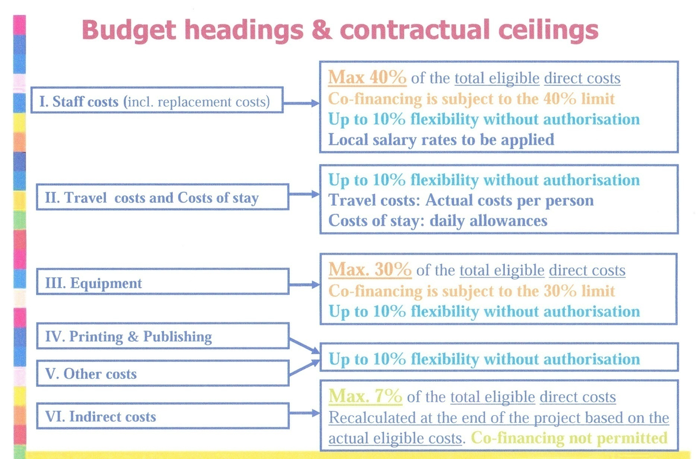
Overview

Slide 12
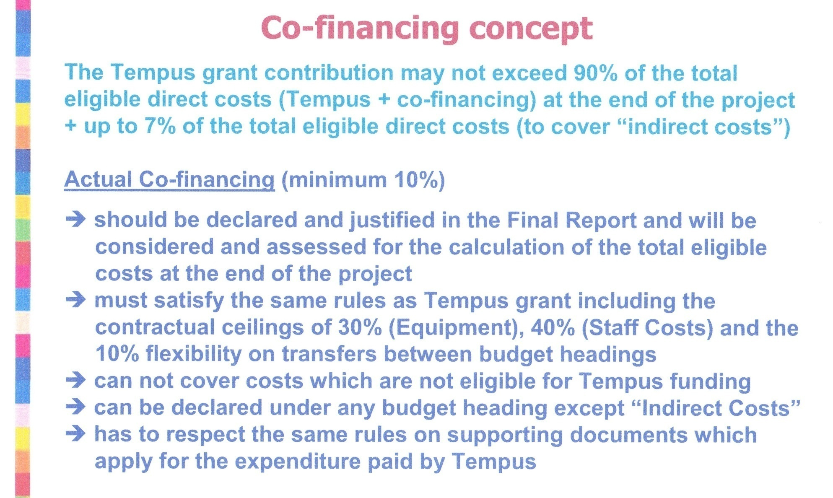
Overview

Slide 13
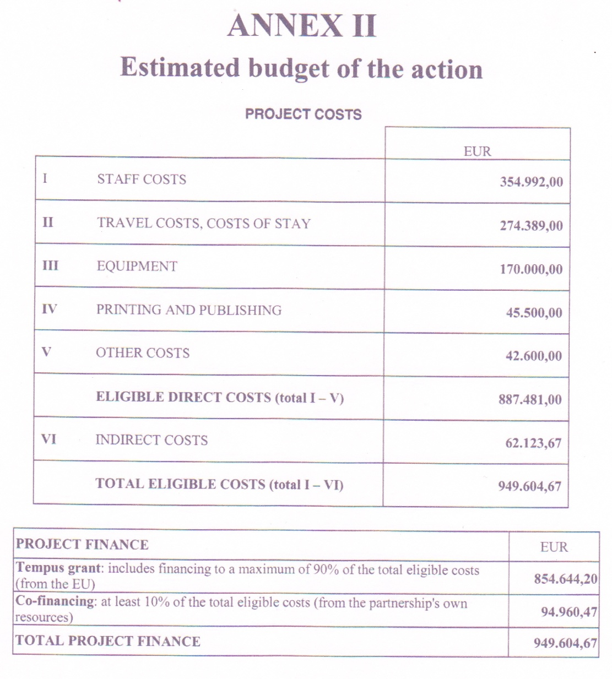
Overview

Slide 14
Summary Project
Funding
Costs applied acc. By EU cofin appl. % of Fund
Staff costs 363.542 € 354.992 € 35.499 € 40 %
Travel Costs and Stay 274.389 € 274.389 €
Equipment 184.400 € 170.000 € 30 %
Printing & Publishing 45.500 € 45.500 €
Other Costs 42.600 € 42.600 €
Total Elig. Dir.Cost 910.431 € 887.481 € 94.960 €
Indirect Costs 63.730 € 62.124 €
Total Elig. Costs 974.161 € 949.605 €
Project Finance
Tempus Grant Request. 876.745 € 854.644 €
Co-financing 97.416 € 94.960 €
Indirect Costs 62.124 € 62.124 €
Total Proj. Finance 974.161 € 949.605 €

Slide 15
Overview

Slide 16
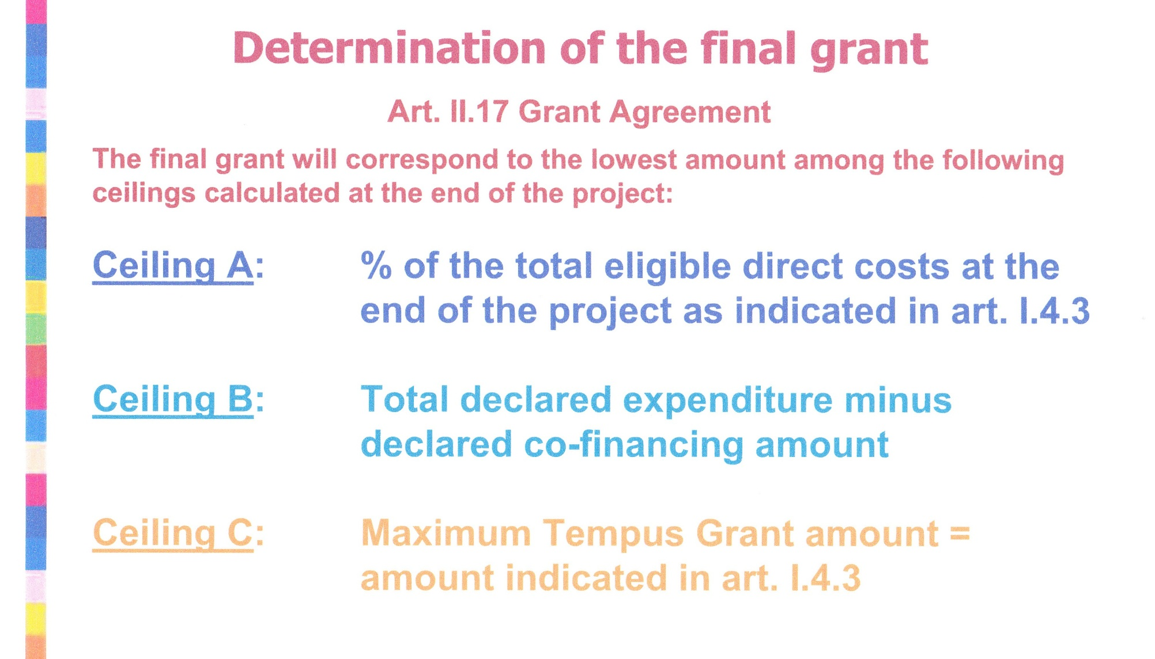
Overview

Slide 17
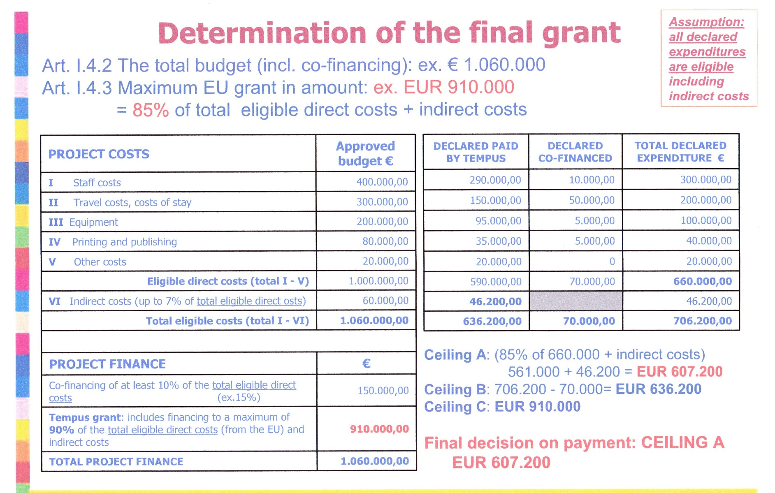
Overview

Slide 18
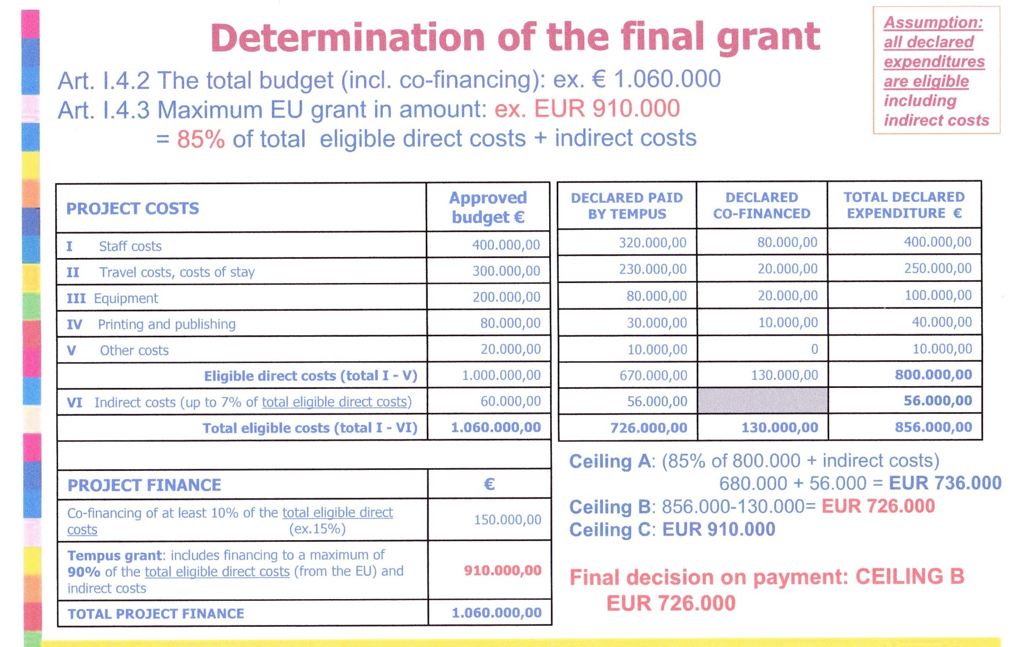
Overview

Slide 19
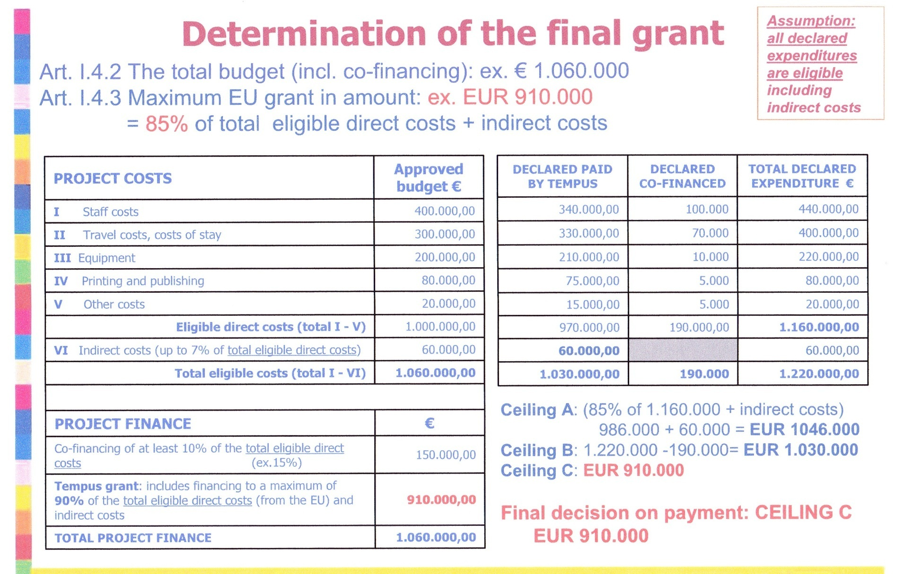
Overview

Slide 20
Summary Project
Funding
Costs applied acc. By EU cofin appl. cofin. nec. Fin. Fund. % of Fund
Staff costs 363.542 € 354.992 € 53.250 € 75.000 € 429.992 € 40 %
Travel Costs and Stay 274.389 € 274.389 € 70.000 € 344.389 €
Equipment 184.400 € 170.000 € 32.000 € 202.000 € 19 %
Printing & Publishing 45.500 € 45.500 € 4.500 € 50.000 €
Other Costs 42.600 € 42.600 € 4.500 € 47.100 €
Total Elig. Dir.Cost 910.431 € 887.481 € 94.960 € 186.000 € 1.073.481 €
Indirect Costs 63.730 € 62.124 €
Total Elig. Costs 974.161 € 949.605 €
Project Finance
Tempus Grant Request. 876.745 € 854.644 € 854.644 €
Co-financing 97.416 € 94.960 € 186.000 €
Indirect Costs 62.124 € 62.124 € 62.124 € 6 %
Total Proj. Finance 974.161 € 949.605 € 1.135.605 €

Slide 21
Overview

