Slide 1

DOCTORAL STUDIES AT FACULTY OF MEDICINE UNIVERSITY OF BELGRADE
Predrag Minić
Notes:
Epigenetika se može definisati kao nauka o naslednim promenama u fenotipu, kao što su različiti oblici ekspresije gena, a koje nisu uzrokovane promenama genetskog koda

Slide 2

The Faculty of Medicine, as an academic institution, in accordance with the Law on Higher education, provides all levels of academic grades.
The Law introduced in 2005 significantly changed the character of postgraduate studies at Serbian universities.
Traditional modality of obtaining a Doctor of Sciences degree by writing thesis based on mentor-guided research that lasted 3-5 years, is being phased out by formal/structured doctoral studies of PhD type.
Notes:
Epigenetika se može definisati kao nauka o naslednim promenama u fenotipu, kao što su različiti oblici ekspresije gena, a koje nisu uzrokovane promenama genetskog koda

Slide 3
Initially, two programs of this type were introduced, Molecular Medicine and Epidemiology.
They are fully research-based, extramurally funded, projects.
Seven additional PhD programs (Physiology, Public Health, Endocrinology, Neurology, Reconstructive Surgery, Osteobiology, Cardiology) were developed to allow clinically contextualized research to be used as a basis for a D.Sci. Thesis.
New programs - Neurosciencies, Human Reproduction Perinatology and neonatology are being developed.
Notes:
Epigenetika se može definisati kao nauka o naslednim promenama u fenotipu, kao što su različiti oblici ekspresije gena, a koje nisu uzrokovane promenama genetskog koda

Slide 4
Doctoral studies development
2006
Molecular
Medicine
Epidemiology
2009
Physiological
Sciences
Reconstructive
Surgery
  Endocrinology
Neurology
    Public Health
2010
Skeletal Biology
Cardiology
Notes:
Epigenetika se može definisati kao nauka o naslednim promenama u fenotipu, kao što su različiti oblici ekspresije gena, a koje nisu uzrokovane promenama genetskog koda

Slide 5

Faculty of medicine Belgrade is a member of ORPHEUS (Organisation for PhD Education in Biomedicine and Health Sciences in the European System), and has structured all its PhD programs according to the principles of this organization.
Notes:
Epigenetika se može definisati kao nauka o naslednim promenama u fenotipu, kao što su različiti oblici ekspresije gena, a koje nisu uzrokovane promenama genetskog koda

Slide 6
Study program goals
Applying the results of experimental, clinical or epidemiological research in everyday practice, achieved through the development of practical skills required to organize research in the laboratory, clinical setting or population whether they consist of experimental animals, healthy subjects or patient groups.
Education of staff for universities, research institutes and other specialized facilities which are required by their programs to conduct and apply results of different types of research.
Notes:
Epigenetika se može definisati kao nauka o naslednim promenama u fenotipu, kao što su različiti oblici ekspresije gena, a koje nisu uzrokovane promenama genetskog koda

Slide 7

The number of enrolled PhD Students per year
74
65
54
19
21
Selection of candidates is primarily based on the candidates’ level of achievement in previous studies.
The main criteria for selection are based upon marks in course work, graduation work (GPA over 8.00/10.00), previous scientific research work, research articles, student scientific awards, professional specialization or degrees from other high level programs.

Slide 8

The structure of course
Educational part | Research part | Other activities
Obligatory modules Facultative module | Realization of PhD thesis project | Journal Clubs Rotations (Laboratories, Clinical Research Units, Population Survey) Essays, presentations, publication
The duration of PhD training , as the third cycle step study program, is 3 years (180 ECTS) and it consists of structured courses and original research. The mandatory training component comprises 30 ECTS, corresponding to a half year of workload. Science theory, ethics and dissemination of research results are mandatory elements in the training. Besides, accompanying courses provide advanced education and skills in the field of the respective thematic program.

Slide 9
Conditions for completing the program
and the doctoral degree
The PhD projects must be part of an internationally peer-reviewed project. First authorship of at least one peer-reviewed publication in a scientific journal covered by SCI or CC with IF of at least 0.3 is compulsory.
The research work is written up as thesis (monograph). The thesis is evaluated by Advisory board and by a committee consisting of two internal and one external opponent.
If approved, the thesis is defended in public by discussing the research findings with the opponents.
Notes:
Epigenetika se može definisati kao nauka o naslednim promenama u fenotipu, kao što su različiti oblici ekspresije gena, a koje nisu uzrokovane promenama genetskog koda

Slide 10
Study program outcomes
After completing the doctoral studies in the field of Medical Sciences, researchers should be capable of:
designing and conducting various types of experimental, clinical or epidemiological types of research;
database management, statistical analyses and research result interpretation, research protocol development, including the preparation of a project proposal, critical analysis and interpretation of medical expert and scientific literature, and
should become competent in a field of research which will be the subject of their research project or doctoral dissertation.
Notes:
Epigenetika se može definisati kao nauka o naslednim promenama u fenotipu, kao što su različiti oblici ekspresije gena, a koje nisu uzrokovane promenama genetskog koda

Slide 11
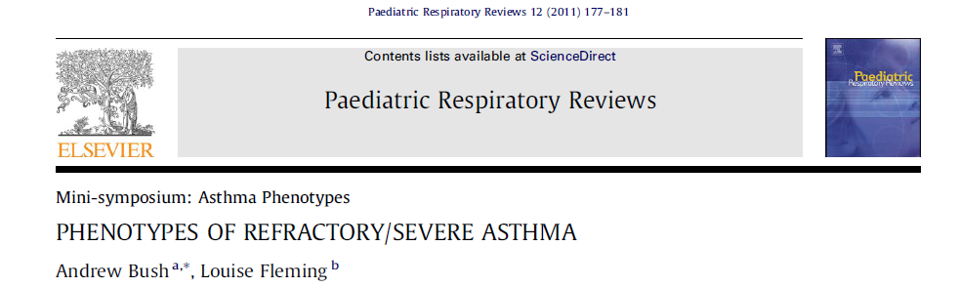

UTILITY
Notes:
Epigenetika se može definisati kao nauka o naslednim promenama u fenotipu, kao što su različiti oblici ekspresije gena, a koje nisu uzrokovane promenama genetskog koda

Slide 12
Total health expenditure in different European countries
(€ per capita/year)

Slide 13
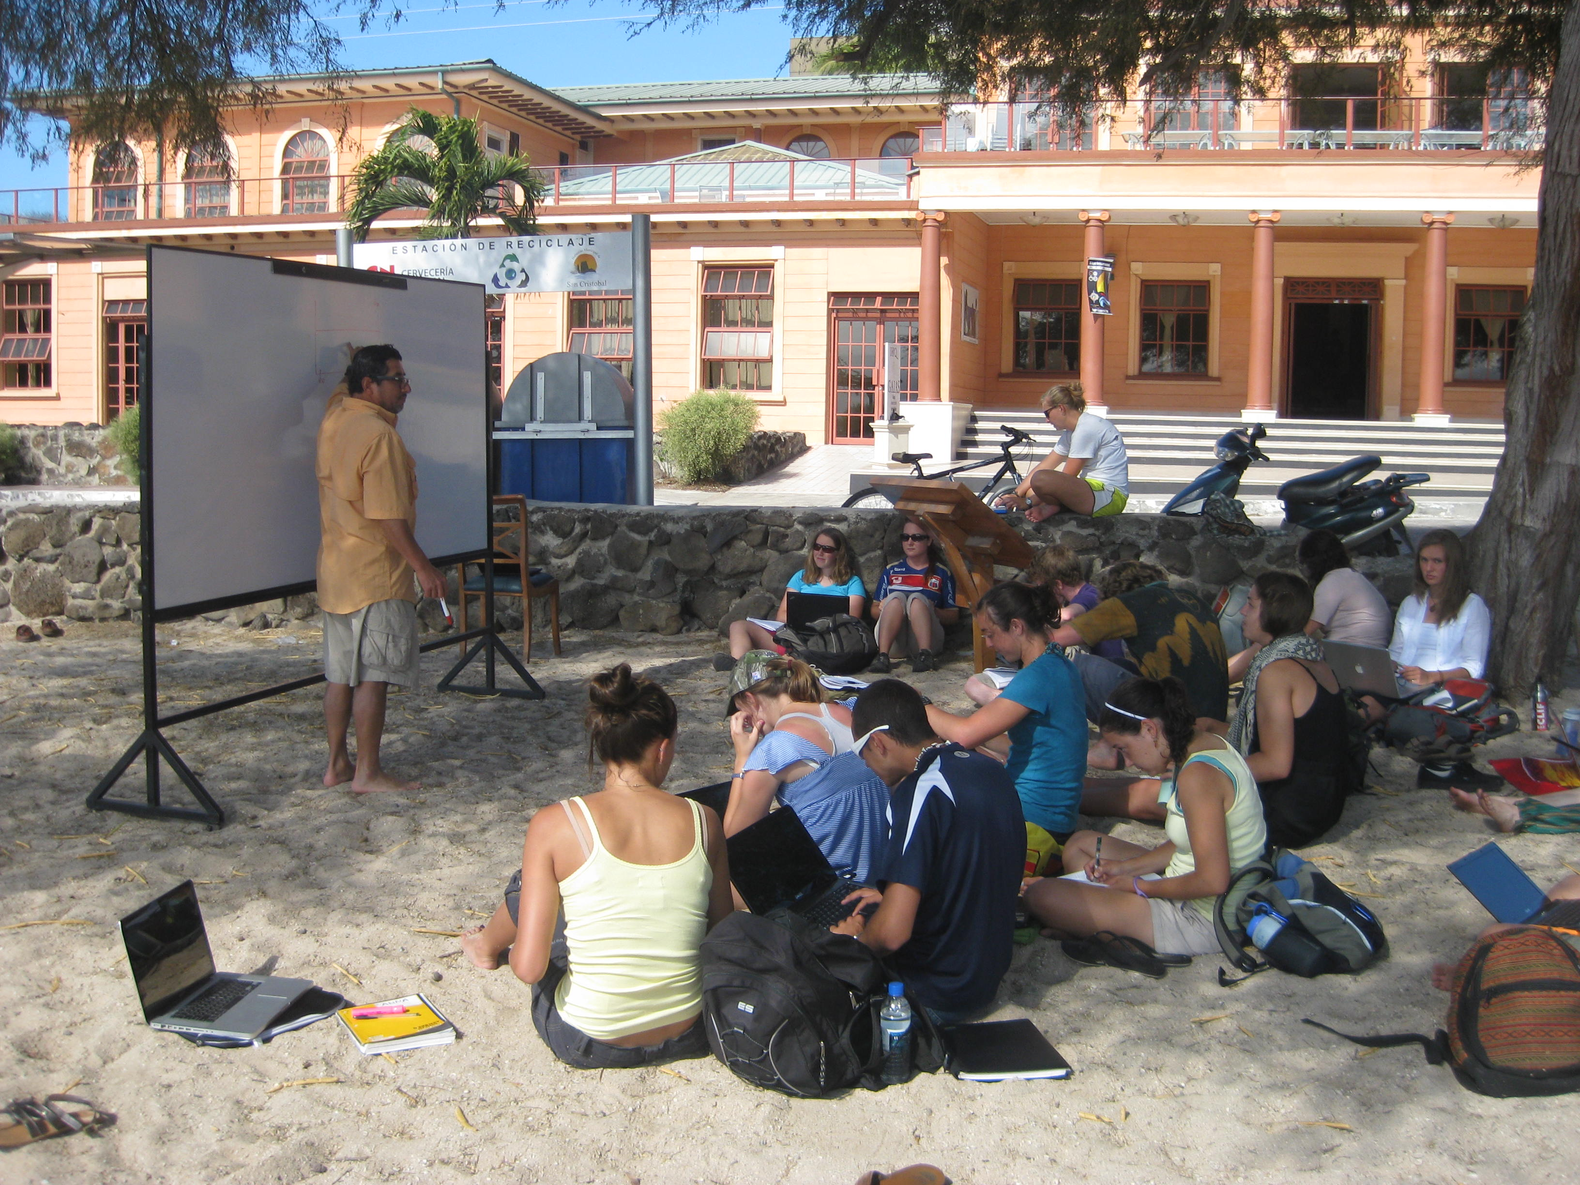
Notes:
Epigenetika se može definisati kao nauka o naslednim promenama u fenotipu, kao što su različiti oblici ekspresije gena, a koje nisu uzrokovane promenama genetskog koda

